Slide 1
HEALTH SAFETY REPORT
This project demonstrates the health and safety event report using IOT to send clinical data between the government ,PSO and the reporters(Hospital/Individual)
Made By :- Darshak Shah(NUID : 001669665)

Slide 2
Problem Statement
The objective here is to build an application to enable hospitals, clinics, clinicians, and patients to report medical safety problems in an anonymous way.
Medical errors are responsive for so many deaths and injuries world-wide.
The knowledge developed is used to define best practices that help avoid clinical errors.

Slide 3
Probable Solution
The reported adverse events must encompass all kinds of medical categories to make it easier for organize make effective use of the gathered data.
The system must be world-wide and allow for access from any country where users can report adverse events in their locality.
Look up the “safety Rule” on the HHS website.

Slide 4
Object Model

Slide 5
Ecosystem(Health System Model)

Slide 6
Validation Check(WorkFlow)

Slide 7
Use Case Diagram

Slide 8
Key Roles
Hospital Reporter(Doctor/Staff Member/Nurse): Reports the clinical error to the area PSO
Individual Reporter(Can be anonymous) : Reports the clinical Error to the Area PSO
PSO(Patient Safety Organization):Area Dependent and can validate the report received from the Hospital and Individual Reporter for further Processing to the Government
Government Analyst : Can see the region and category wise reports of all the clinical Errors and see report details received from PSO.

Slide 9
Key Features
Fulfilling the standard guidelines of the Safety Rule.(link : https://www.ismp.org/errorReporting/reportErrortoISMP.aspx)
Participants include hospitals, clinics, government agencies and individuals.
Adverse events of all kinds from devices, medical procedures, human errors, etc.
BI reporting of error patterns detecting chronic violators by regions, practice, etc.
Anonymity of reporters
Creative ideas such as charts, etc.

Slide 10
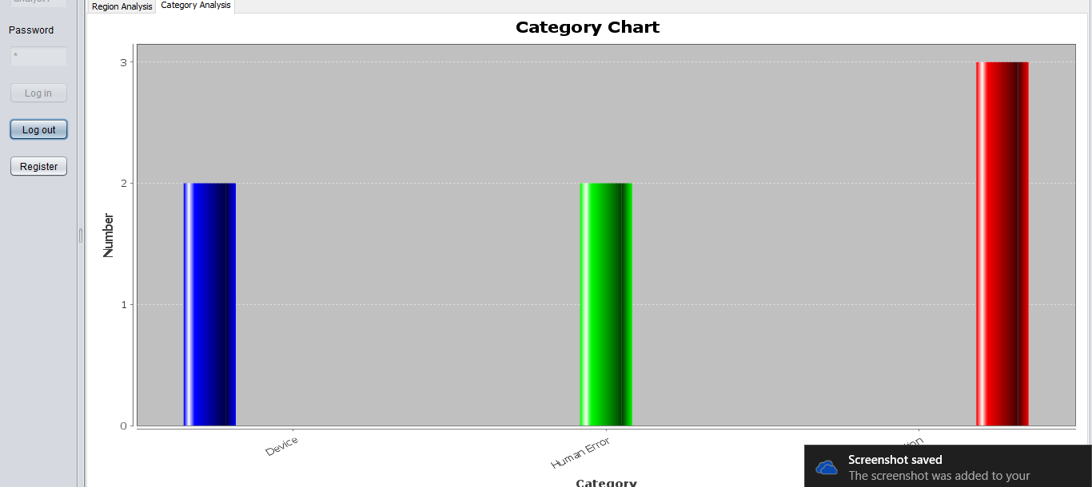
Application Screenshots
Medical Error Category Chart

Slide 11
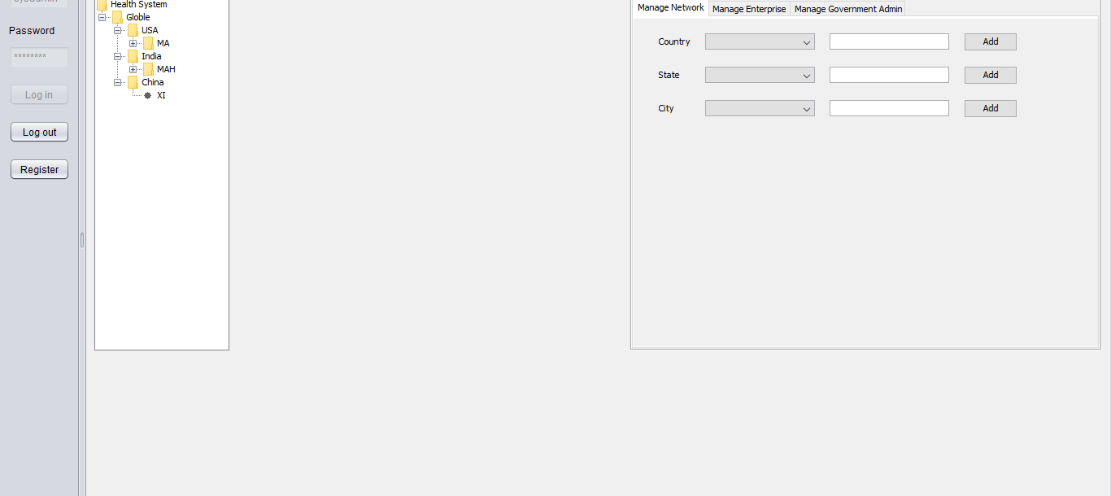
Network Structure
Highlights the Ecosystem Model

Slide 12
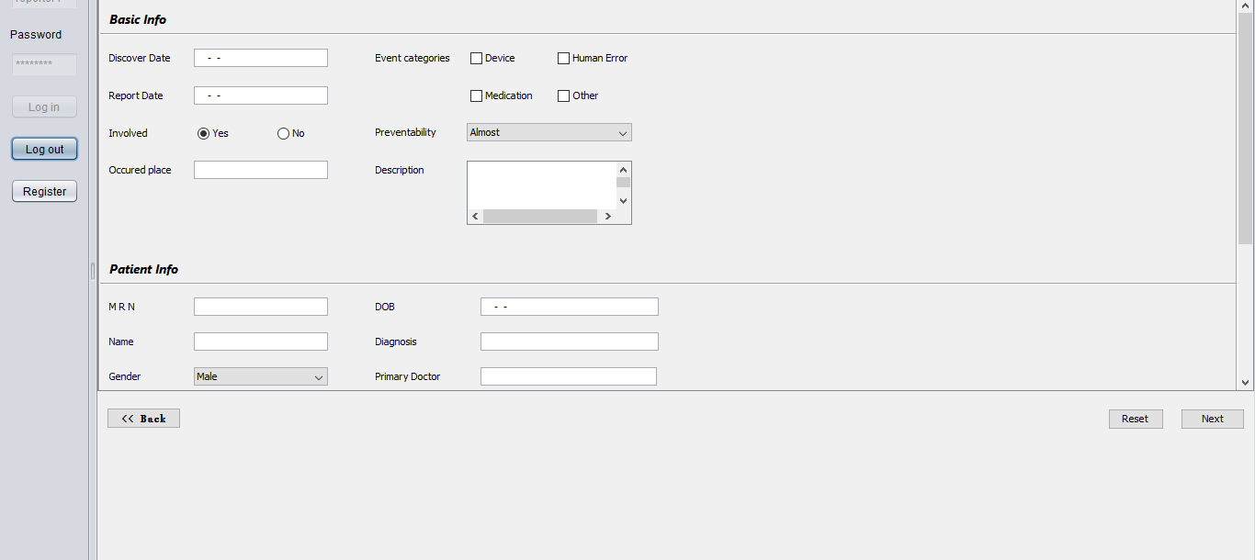
Reporting of Incident

Slide 13
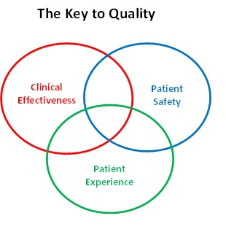
Conclusion
Healthcare Event Reporting Form (HERF)
Identity
Date, Time
Location
Reporter
Narrative
Link to other forms

